Slide 1
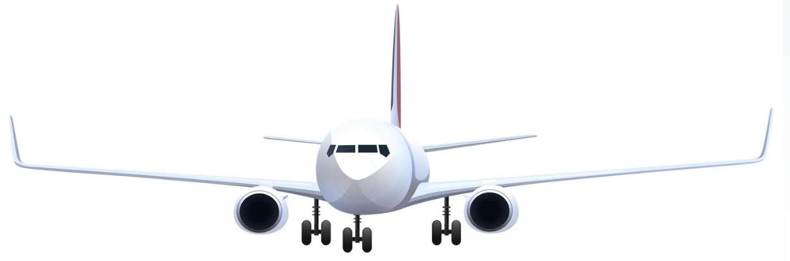

It’s Safe to Fly Airline Safety Analysis
Anthony LaRosa

Slide 2
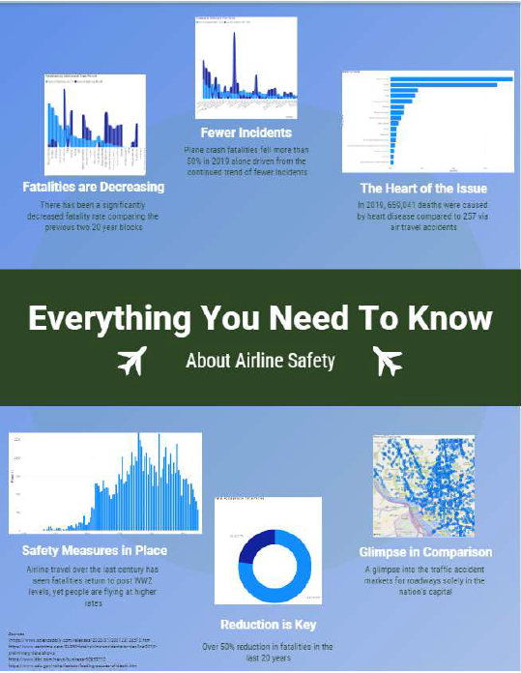

Dashboard

